Slide 1
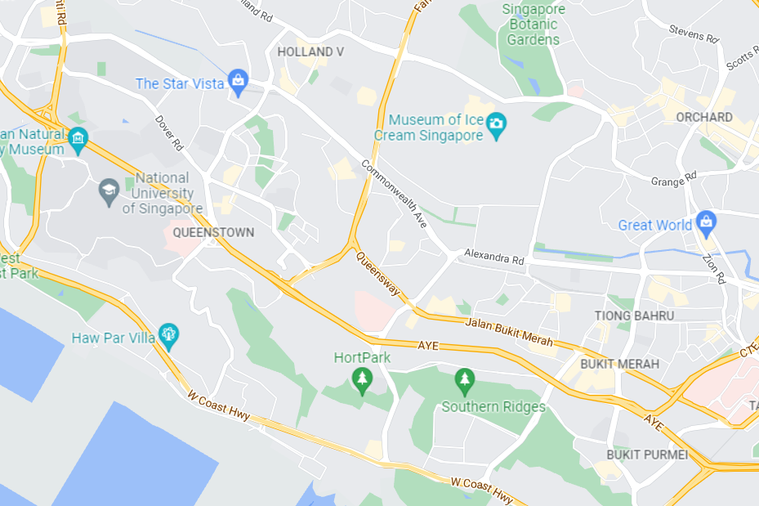

Search for food |

Slide 2
WhaToEat
Search for food |
Filters
Food Type
Spiciness
Soup or Dry
Hot or Cold

Slide 3
WhaToEat
Search for food |
Halal:
Yes
No
Either
Spicy:
Yes
No
Either
hot:
Yes
No
Either
vegetarian:
Yes
No
Either

Slide 4
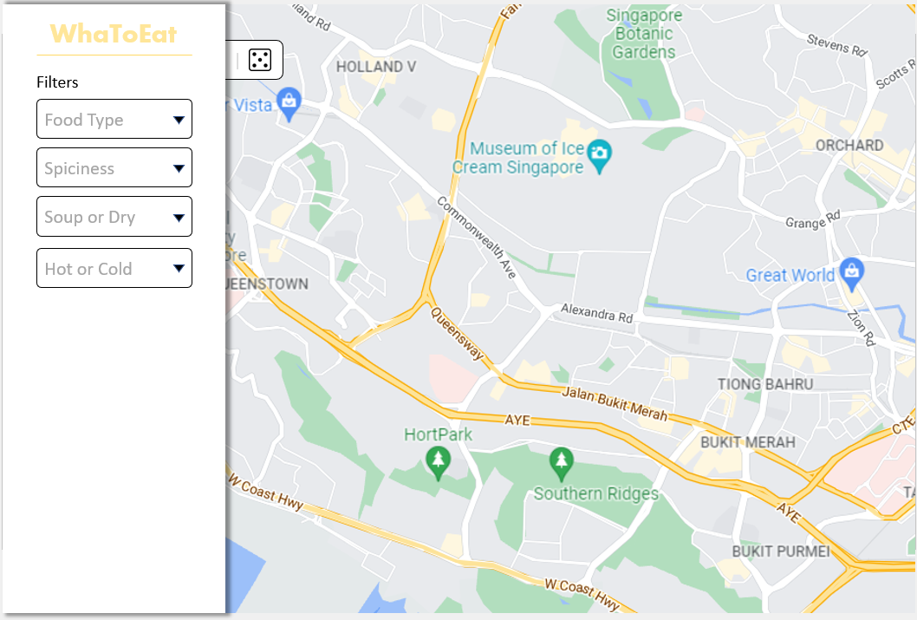
Client-side

Slide 5
WhaToEat

